Slide 1




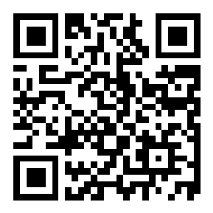
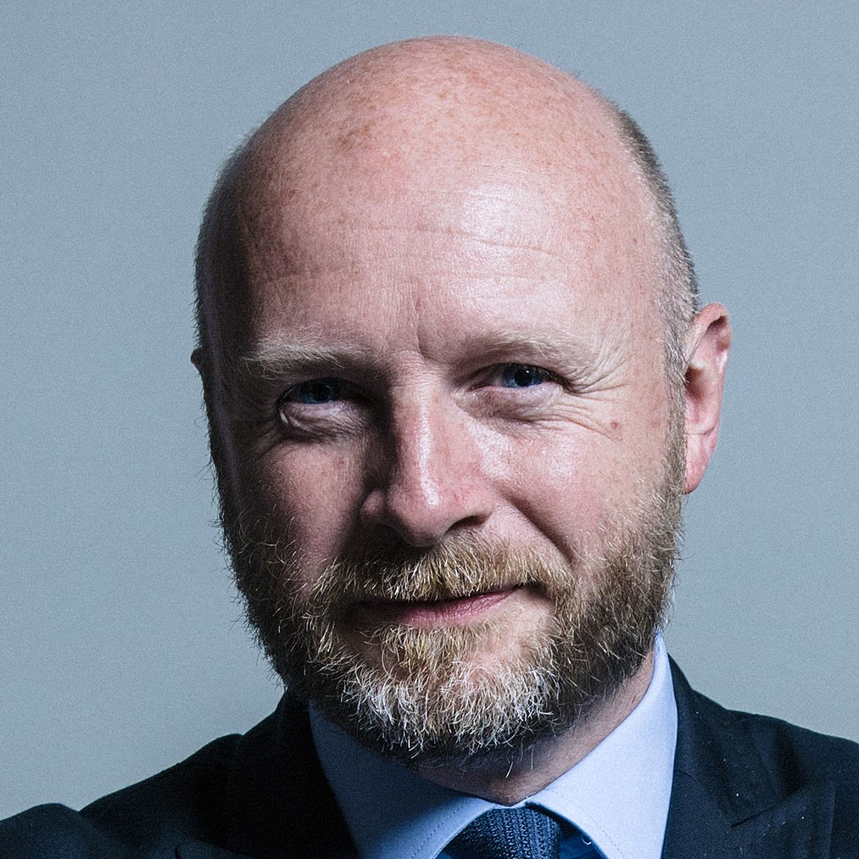
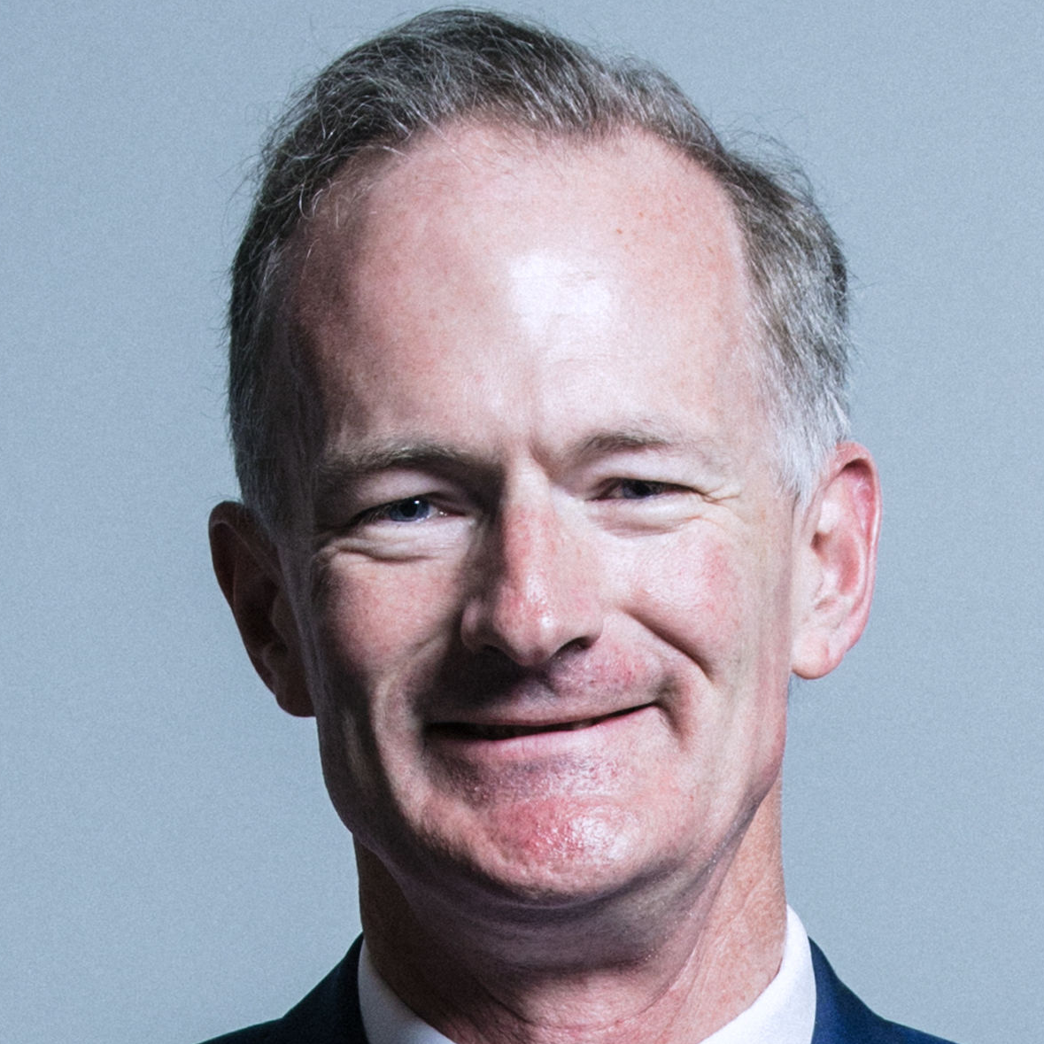
Welcome
slido.com
#3132467
Liam Byrne MP
MP for Birmingham Hodge Hill
Labour
John Penrose MP
MP for Weston-super-Mare
Conservative
Wi-Fi Network: Internet Direct | Username: guest | Password: Fr@nchise1918

Slide 2
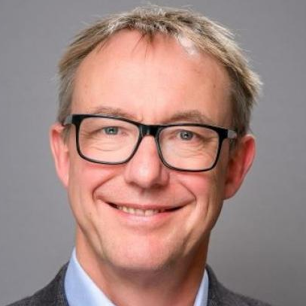
Setting the scene
slido.com
#3132467
Paul Johnson
Institute for Fiscal Studies
Wi-Fi Network: Internet Direct | Username: guest | Password: Fr@nchise1918

Slide 26
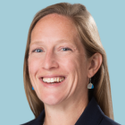
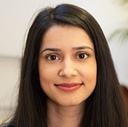
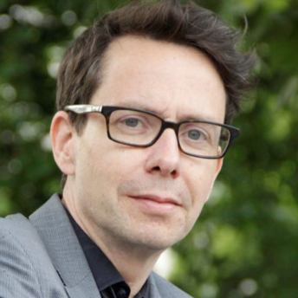
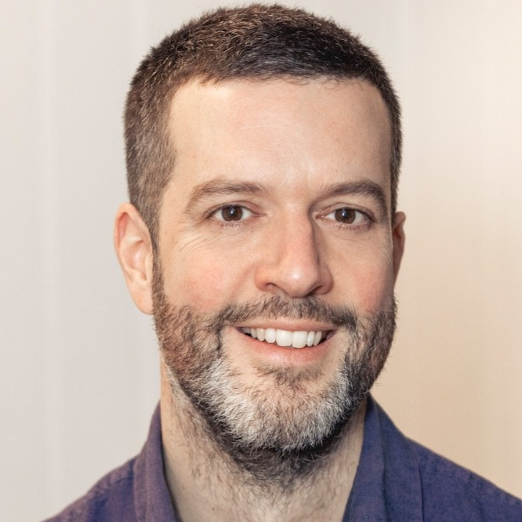
Public attitudes
slido.com
#3132467
Lucy Barnes
UCL
(Chair)
Priya Minhas
Opinium
Bobby Duffy
The Policy Institute,
King’s College London
Will Snell
Fairness Foundation
Wi-Fi Network: Internet Direct | Username: guest | Password: Fr@nchise1918

Slide 27
APPG on Inclusive Growth
The Wealth Gap
Inequality of Wealth- Public perceptions
6th July 2023

Slide 28
Public perceptions of wealth

Slide 29
The public think the wealth gap is too big
Q3 ‘Thinking of wealth levels generally in Britain today, would you say that the gap between those with lots of wealth and those with little wealth is too large, about right, or too small? ’ Base: 2000 nationally representative UK adults

Slide 30
….and getting bigger
Q1 ‘Thinking of wealth levels generally in Britain today, would you say that the gap between those with lots of wealth and those with little wealth is getting bigger, getting smaller or staying roughly the same? ’ Base: 2000 nationally representative UK adults

Slide 31
Three fifths want to see the wealth gap reduced
Q2 ‘Thinking of wealth levels generally in Britain today, would you say the gap between those with high wealth and those with little wealth should be reduced, stay the same, or increased?’ Base: 2000 nationally representative UK adults

Slide 32
Global inequality is also perceived to be growing
46%
Feel that global inequality is growing rapidly.
Q5 ‘Do you think global inequality (the gap between the richest and poorest in societies around the world as a whole) is shrinking or growing, or do you think it is staying about the same?’ Base: 2000 nationally representative UK adults

Slide 33
The public are most worried about the control of the super-rich if global inequality were to rise
If global inequality were to rise, what would you be worried about?
Super-rich unfairly influencing policy
Rising corruption
Difficulty in social mobility
More countries breaking down
Increased power difference between countries
Lack of growth for low-income countries
More outsourcing for manual labour
Other
N/A – None of the above
Don’t know
Q8 ‘If global inequality were to rise, would you be worried about any of the following potential consequences?’ Base: 2000 nationally representative UK adults

Slide 34
The super rich are considered more powerful than national governments
Q6R1 ‘Today, in 2023, which of the following groups do you think has the most power? By ‘power’ we mean the capacity or ability to direct or influence the behaviour of others or the course of events. Please rank from 1 to 7 with 1 having the most power and 7 the least.’ Base: 2000 nationally representative UK adults

Slide 35
And the public expect the super-rich to still hold the most power in 2030
Q6R1 ‘Today, in 2023, which of the following groups do you think has the most power? By ‘power’ we mean the capacity or ability to direct or influence the behaviour of others or the course of events. Please rank from 1 to 7 with 1 having the most power and 7 the least.’ Q7R1. And which of the following groups do you expect will have the most power in 2030? Base: 2000 nationally representative UK adults

Slide 36
The public have mixed views on why the richest in society are wealthy
Is wealth because of hard work or factors outside an individual’s control?
Q4 ‘Thinking about the people in the UK who have the most wealth, to what extent do you think their wealth in the following areas is because of their hard work, or due to factors outside their control?’ Base: 2000 nationally representative UK adults

Slide 37
When asked more specifically, family background is considered the most important determinant for wealth
Factors relating to social background
Factors relating to individual character
Q4B ‘Which of the following reasons, if any, do you think are the most important explanations for why some people have a lot of wealth and others have very little wealth? Please select up to 3 options.’ Base: 2000 nationally representative UK adults

Slide 38
Solutions for reducing inequality
Notes:
.

Slide 39







We tested measures across seven broad areas
Tax system
Health policy
Employment rules
Education policy
Equality policy
Social security policy
Housing and regeneration policy

Slide 40
The public do not see a clear-cut solution to tackling wealth inequality
% who ranked this as the best solution for tackling inequality in Britain over the next 10 years
Improving the tax system
Social security for the poorest in society
Improving everyone’s health
Better education for all
Improving access to affordable housing
Fairer employment
Better Equalities Policy that tackles discrimination
Q17R1 ‘Thinking about all the answers you’ve given above, what solutions do you think would work best to reduce inequality in Britain over the next 10 years?
Please rank the answers from one to seven with one being the solution you believe would work best and seven being the solution you think would work least well.’
Base: 2000 nationally representative UK adults

Slide 41
Reducing tax avoidance scores highest on support and credibility
Q10A. The following are ideas put forward by experts to use the tax system to reduce inequality in Britain. Which measures would you support most?
Please rank the answers from one to five, with one being the measure you support most, and five being the one you support least.
Q10B. And to what extent do you think the following measures are or are not credible for a new UK Government to introduce? By credible we mean whether you think it is possible for a new UK Government to introduce the idea and that you believe they would follow through with it if they promised it. Base: 2000 nationally representative UK adults

Slide 42
Reducing tax avoidance is also seen as the tax measure that would work best to reduce inequality
Q10A. The following are ideas put forward by experts to use the tax system to reduce inequality in Britain. Which measures would you support most?
Please rank the answers from one to five, with one being the measure you support most, and five being the one you support least.
Q10C. And if they were introduced, which measures do you think would work best to reduce inequality within the next five years? Please rank the answers from one to five, with one being the measure you believe would work best and five being the measure you think would work least well. Base: 2000 nationally representative UK adults

Slide 43
Ensuring benefits are high enough for those with ill health has the highest level of support, and scores one of the highest on credibility too
Q15A. The following are ideas put forward by experts to use the social security system to reduce inequalities in Britain. Which measures would you support most? Please rank the answers from one to six, with one being the measure you support most, and six being the one you support least.
Q15B. And to what extent do you think the following measures are or are not credible for a new UK Government to introduce? By credible we mean whether you think it is possible for the Government to introduce the idea and/or you believe they would follow through with it if they promised it. Base: 2000 nationally representative UK adults

Slide 44
UBI ranks highest on working the best, despite lower levels of support
Q15A. The following are ideas put forward by experts to use the social security system to reduce inequalities in Britain. Which measures would you support most? Please rank the answers from one to six, with one being the measure you support most, and six being the one you support least.
Q15C. And if they were introduced, which measures do you think would work best to reduce inequality within the next five years? Please rank the answers from one to six, with one being the measure you believe would work best and six being the measure you think would work least well. Base: 2000 nationally representative UK adults

Slide 45
The clear-cut winners
Solution area | Top performing measure
Tax system | Reducing tax avoidance and use of tax havens
Housing and regeneration policy | Build more social housing
Equality policy | Making sure men and women are paid the same for the same work

Slide 46
Strong performers
Solution area | Top performing measure
Education policy | More money for schools, smaller class sizes and better SEN services scores highest for support and effectiveness. Improving availability of high-quality apprenticeships is seen as the most credible and performs well on the other two criteria. Lower cost childcare for 30 hours a week for children 18 months+ also performs well across the 3 criteria.
Employment rules | Raising the minimum wage from current level of £9.50 scores highest on credibility and effectiveness, and close second on support. Rules to fix the top pay of CEOs performs well on support and credibility, but less well on effectiveness
Social security system | Ensuring benefits for those with ill health are high enough to prevent poverty scores highest on support, 2nd place on credibility and effectiveness. UBI performs well but is lower on credibility.

Slide 47
A mixed picture
Solution area | Top performing measure
Health policy | 3 measures perform fairly in line: Improving everyone’s access to mental health services Improving everyone's access to affordable nutritious food Stronger social care services

Slide 48
4 key take outs
1
The public are concerned about inequality and think it is growing bigger
2
The public believe the super-rich hold the most power in society; their biggest concern about rising inequality is the super-rich unfairly influencing policy
.
3
The public do not have one clear cut broad solution to focus on to reduce inequality
There are however some measures that perform better than others in some of the key areas, particularly when it comes to using the tax system, equality policy and housing policy
4

Slide 49
Towards the Manifestos:
Common ground?
Bobby Duffy
The Policy Institute,
King’s College London
Wi-Fi Network: Internet Direct | Username: guest | Password: Fr@nchise1918

Slide 50
The perception of power sitting with the very wealthy seems to be a shift from 2018…
2023 survey: Today, in 2023, which of the following groups do you think has the most power? By “power” we mean the capacity or ability to direct or influence the behaviour of others or the course of events. Please rank from 1 to 7 with 1 having the most power and 7 the least.
(% who rank each as having the most power)
2018 survey: Today in 2018, which of the following groups do you think has the most power? By “power” we mean the capacity or ability to direct or influence the behaviour of others or the course of events.
(% who select each option)
*2018 survey asked about “International organisations e.g. the EU, G7 etc”
Base: 2,000 UK adults aged 18+, surveyed 27 Feb–6 Mar 2023, and 2,007 surveyed 29 March-3 April 2018

Slide 51
…looking back to 2018, we’re just ahead of schedule?
2023 survey: And which of the following groups do you expect will have the most power
in 2030? By “power” we mean the capacity or ability to direct or influence the behaviour of others or the course of events. Please rank from 1 to 7 with 1 having the most power and 7 the least. (% who rank each as having the most power)
2018 survey: And who do you expect will have the most power in 2030? By ‘power’ we mean the capacity or ability to direct or influence the behaviour of others or the course of events. (% who select each option)
*2018 survey asked about “International organisations e.g. the EU, G7 etc”
Base: 2,000 UK adults aged 18+, surveyed 27 Feb–6 Mar 2023, and 2,007 surveyed 29 March-3 April 2018

Slide 52
There are two or three dividing lines on many solutions: age, politics and mindset…
BUT big picture is significant consistency, with a few exceptions

Slide 53
1. Eg very consistent views of tax system measures…
The following are ideas put forward by experts to use the tax system to reduce inequality in Britain. Which measures would you support most? Please rank the answers from one to five, with one being the measure you support most, and five being the one you support least. (% who rank each as number one)
Base: 2,000 UK adults aged 18+, surveyed 27 Feb–6 Mar 2023

Slide 54
A third dividing line? Individualist versus structuralist mindsets
Thinking about the people in the UK who have the most wealth, to what extent do you think their financial wealth (investments, cash) is because of their hard work, or due to factors outside their control?
Base: 2,000 UK adults aged 18+, surveyed 27 Feb–6 Mar 2023

Slide 55
…but structuralists and individualists are also in broad agreement on the appeal of different tax system solutions
The following are ideas put forward by experts to use the tax system to reduce inequality in Britain. Which measures would you support most? Please rank the answers from one to five, with one being the measure you support most, and five being the one you support least. (% who rank each as number one)
Base: 2,000 UK adults aged 18+, surveyed 27 Feb–6 Mar 2023

Slide 56
2. More marked differences on social security measures…
The following are ideas put forward by experts to use the social security system to reduce inequalities in Britain. Which measures would you support most? Please rank the answers from one to six, with one being the measure you support most, and six being the one you support least. (% who rank each as number one)
Base: 2,000 UK adults aged 18+, surveyed 27 Feb–6 Mar 2023

Slide 57
2. Structural/individualist split mirrors Labour/Cons split
The following are ideas put forward by experts to use the social security system to reduce inequalities in Britain. Which measures would you support most? Please rank the answers from one to six, with one being the measure you support most, and six being the one you support least. (% who rank each as number one)
Base: 2,000 UK adults aged 18+, surveyed 27 Feb–6 Mar 2023

Slide 58
3. Labour and Conservative voters are equally supportive of rules to fix CEO pay, interesting age profiles on minimum wage and zero hours contracts…
The following are ideas put forward by experts to use employment rules to reduce inequality in Britain. Which measures would you support most? Please rank the answers from one to five, with one being the measure you support most, and five being the one you support least. (% who rank each as number one)
Base: 2,000 UK adults aged 18+, surveyed 27 Feb–6 Mar 2023

Slide 59
3. Structuralists are more supportive of government intervention to cap CEO pay
The following are ideas put forward by experts to use employment rules to reduce inequality in Britain. Which measures would you support most? Please rank the answers from one to five, with one being the measure you support most, and five being the one you support least. (% who rank each as number one)
Base: 2,000 UK adults aged 18+, surveyed 27 Feb–6 Mar 2023

Slide 60
Overall…
Public are worried about inequality, and increasingly recognise the shifting power from extreme wealth concentration
There are important differences in support for some suggested responses by lifestage, politics and broader mindset – but the bigger picture is of relatively consistency: plenty of potential for common ground?
But need to consider wider attitudinal context: relatively low salience and knowledge; fixed mental image; strong individualistic/meritocratic starting point…
Focus the debate away from the minority of benefit claimants who are out of work to “the majority who earn their poverty” or unable to work through disability/childcare?
Focus on inequality of opportunity, to bridge individualist and structuralist mindsets?
And of course, opinion is shaped: political and media portrayals matter…
… have only measured a selection of solutions - many more could consider…

Slide 61
Public attitudes
slido.com
#3132467
Lucy Barnes
UCL
(Chair)
Priya Minhas
Opinium
Bobby Duffy
The Policy Institute,
King’s College London
Will Snell
Fairness Foundation
Wi-Fi Network: Internet Direct | Username: guest | Password: Fr@nchise1918

Slide 62
Tea
slido.com
#3132467
Wi-Fi Network: Internet Direct | Username: guest | Password: Fr@nchise1918

Slide 63

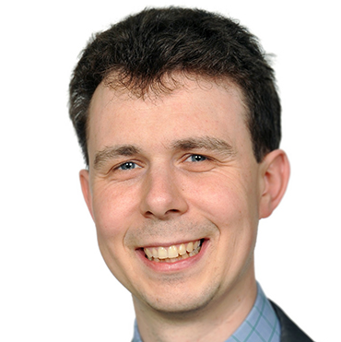
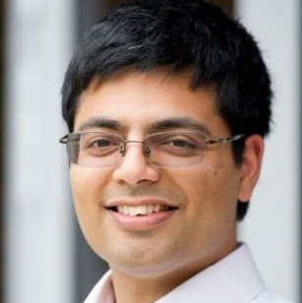
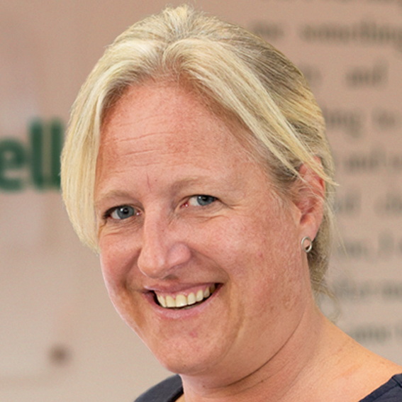
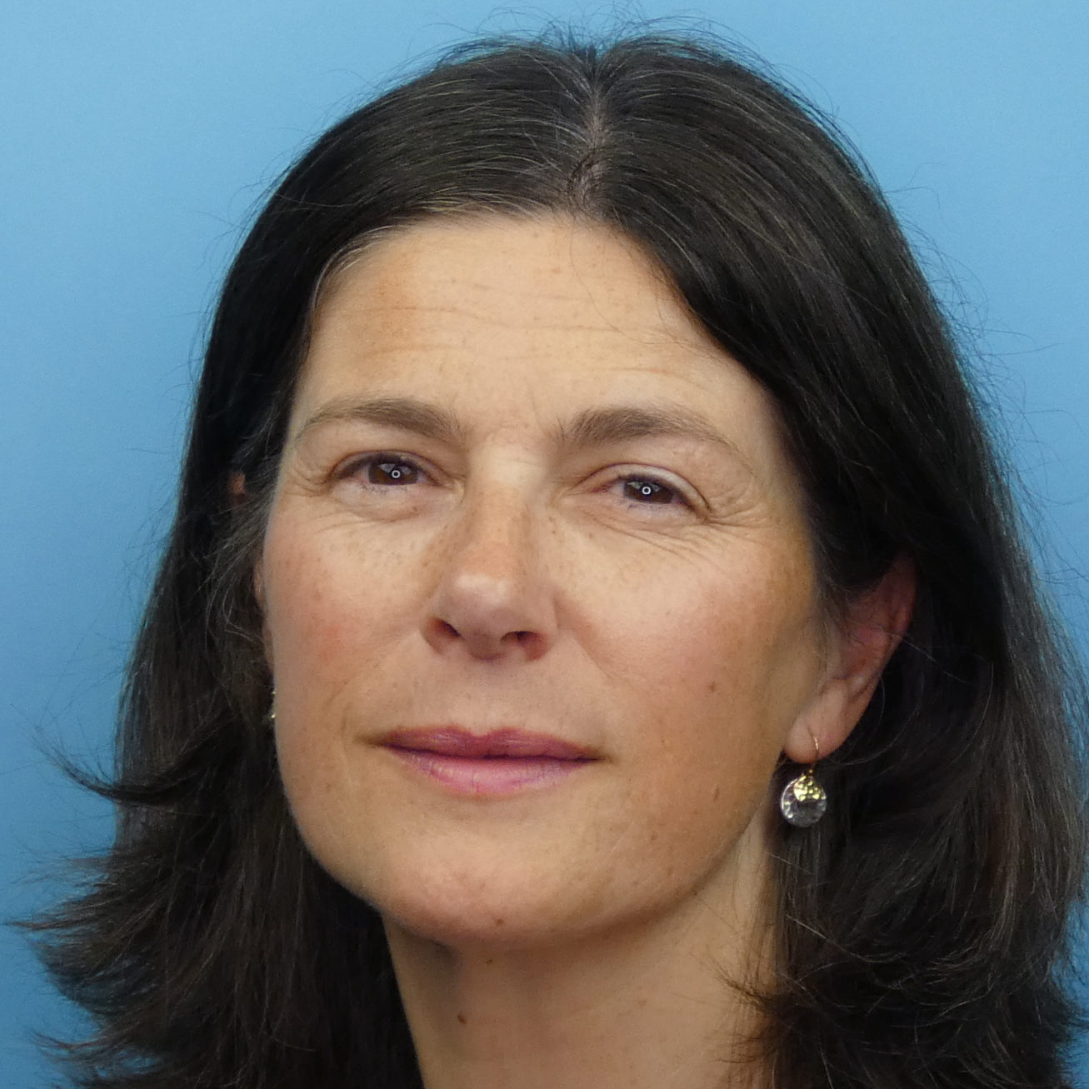
What works?
slido.com
#3132467
Ryan Shorthouse
Bright Blue
(Chair)
Iain Mansfield
Policy Exchange
Arun Advani
University of
Warwick
Emma Revie
Trussell Trust
Lindsay Judge
Resolution Foundation
Wi-Fi Network: Internet Direct | Username: guest | Password: Fr@nchise1918

Slide 64
Finding common ground
slido.com
#3132467
Liam Byrne MP
MP for Birmingham Hodge Hill
Labour
John Penrose MP
MP for Weston-super-Mare
Conservative
Wi-Fi Network: Internet Direct | Username: guest | Password: Fr@nchise1918

Slide 65
Concluding remarks
slido.com
#3132467
Bobby Duffy
The Policy Institute,
King’s College London
Wi-Fi Network: Internet Direct | Username: guest | Password: Fr@nchise1918

Slide 66
Roundtable summary
Addressing inequalities in carbon emissions / consumption
Actions for climate change mitigation and adaptation
Trades unions (worker representation)
Tackling air pollution and damp housing
People keeping more of their benefits as they earn more (less steep taper)
Two child cap on benefits
Helping people with prices (energy and food, alongside rent caps)
Community fabric - social isolation etc
Early intervention in health, addictions, chronic conditions
Citizenship / PSHE curriculum to support agency
Housing quality
Local economic growth
Proportional representation
Universal basic capital
Universal basic services (including public transport)

Slide 67
Thank you

